Slide 1

SPRINT 3
Suggested the Grippers_Servos for Robot Arm
Fixed the gripper SG90 copying the other robot
Looked for potentiometer online (but replaced with Gyros)
Fixed the Auto-start Firewall Issue using a Linux commands
Tried soldering the shield (Unsuccessful by me)
Ran Wifi_MQTT Sample program on Arduino (Connected with my Hotspot)
Also, ran BME280 Arduino Program and visualized in Serial Plotter
Finally Completed Documentation of Lab Instructions & Setup Procedures (Corrections welcome)
Currently interpretating Gyro programs in order to merge it with wifi_MQTT

Slide 2
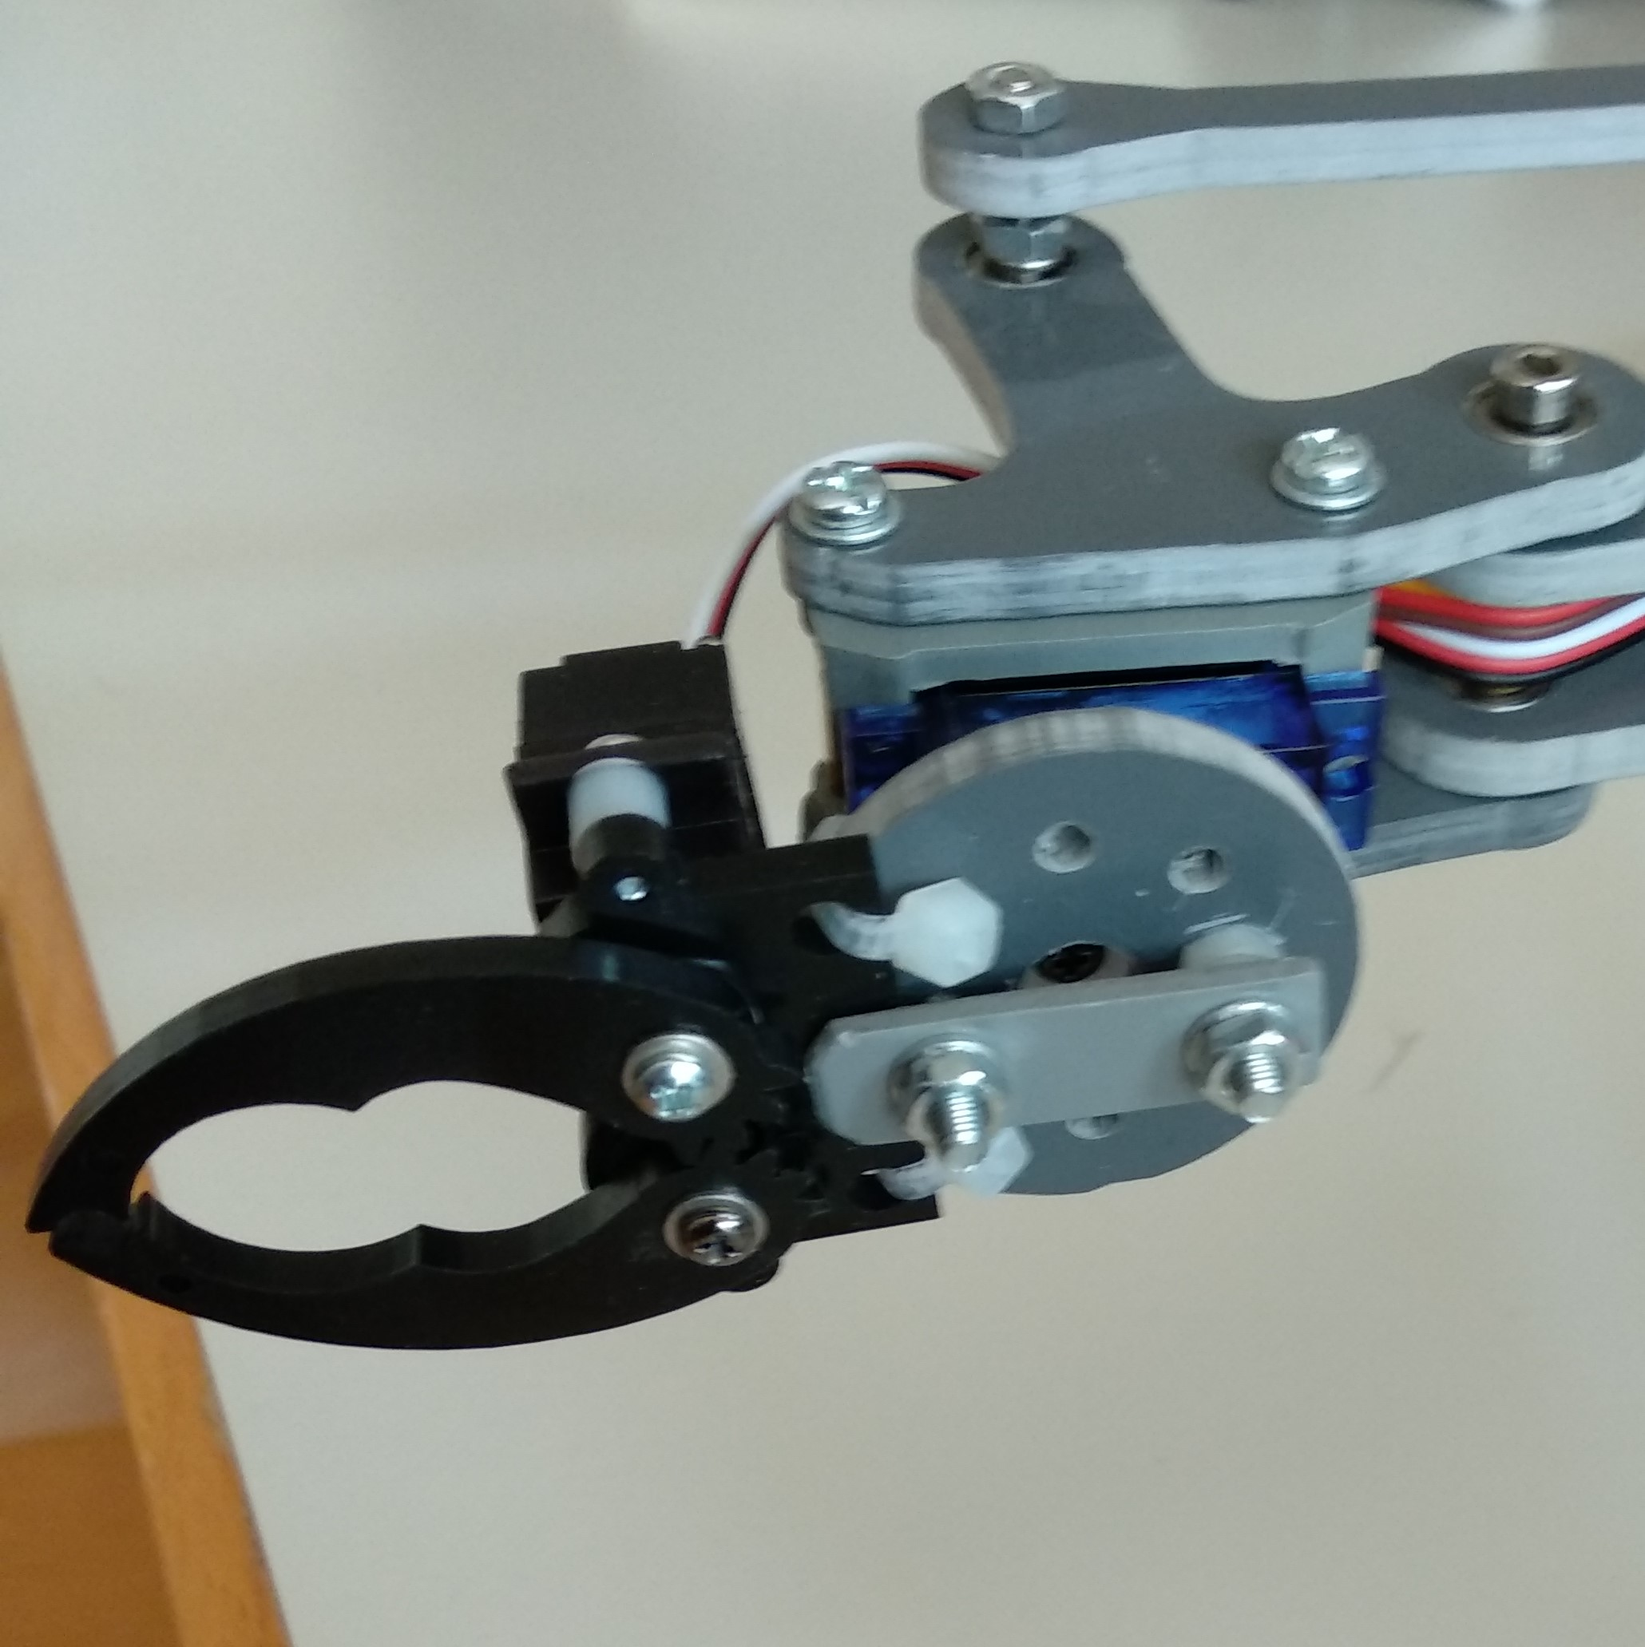
SPRINT 3
Linux Command Used: > # /etc/init.d/iptables-persistent save
This command takes current configuration of your iptables and saves it to the rules.v4
The Servo Gripper assembled are
shown here:
Robot shield & Soldered part are in
(next slide)

Slide 3
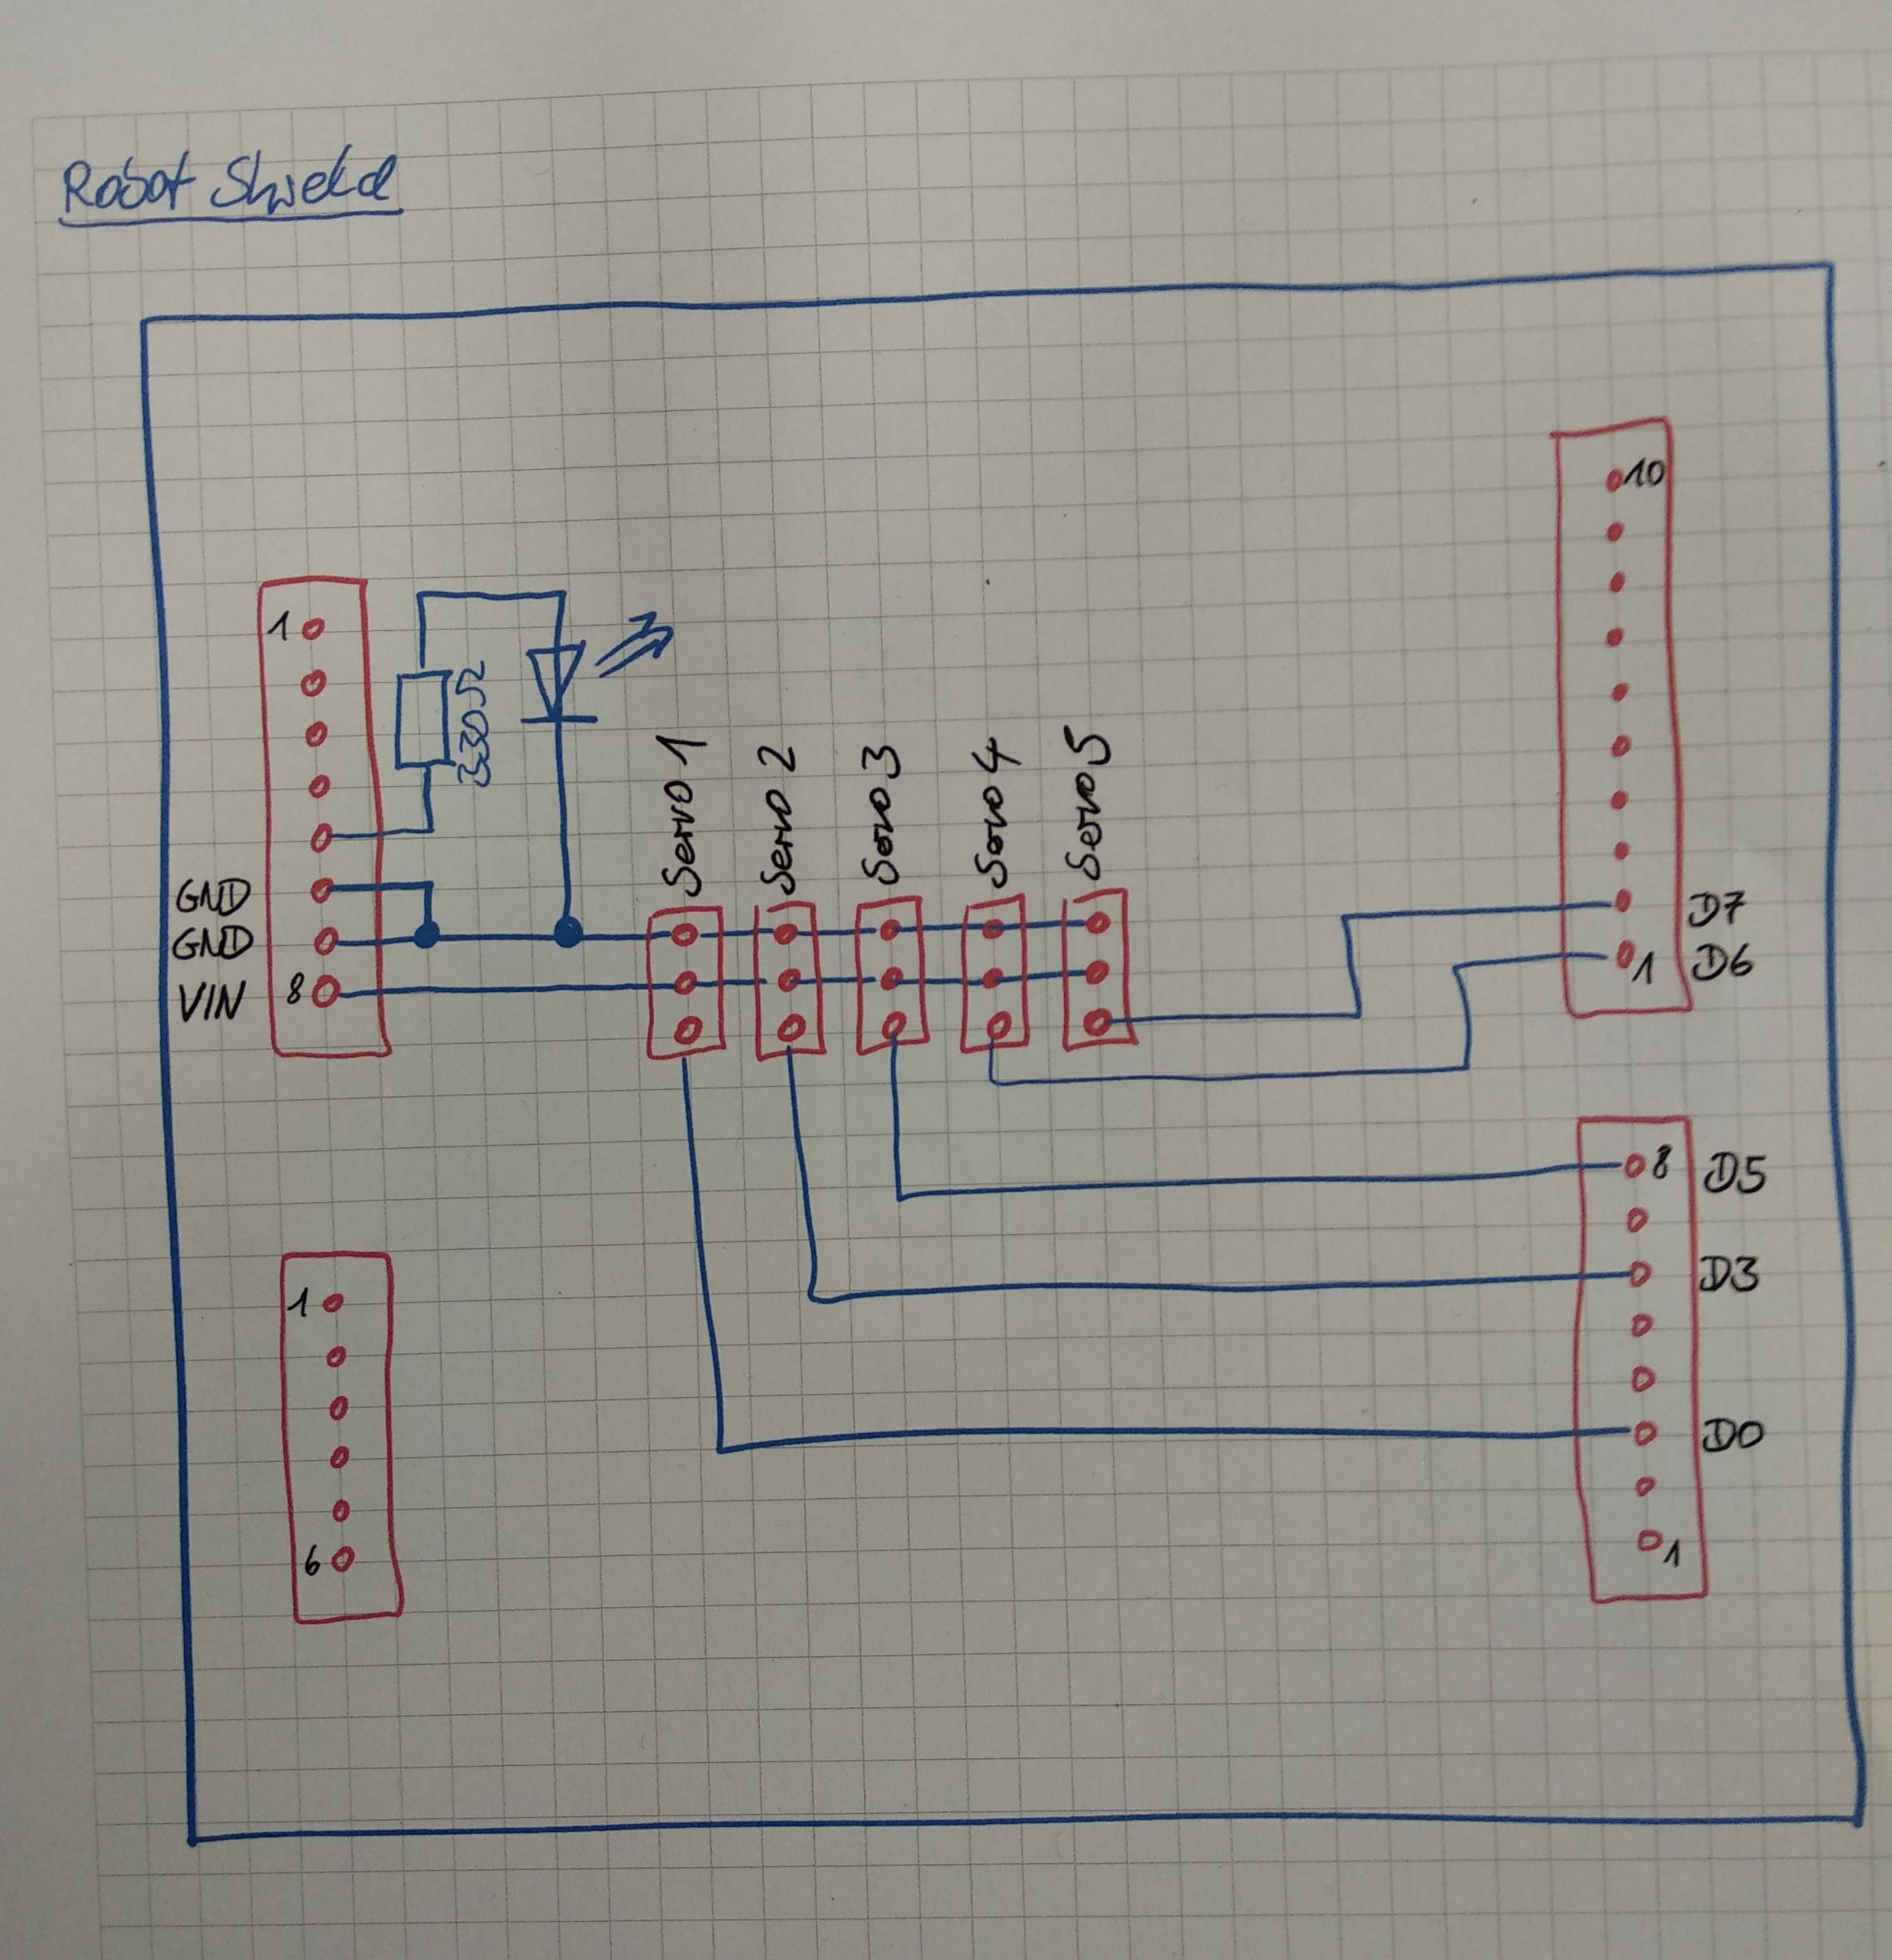
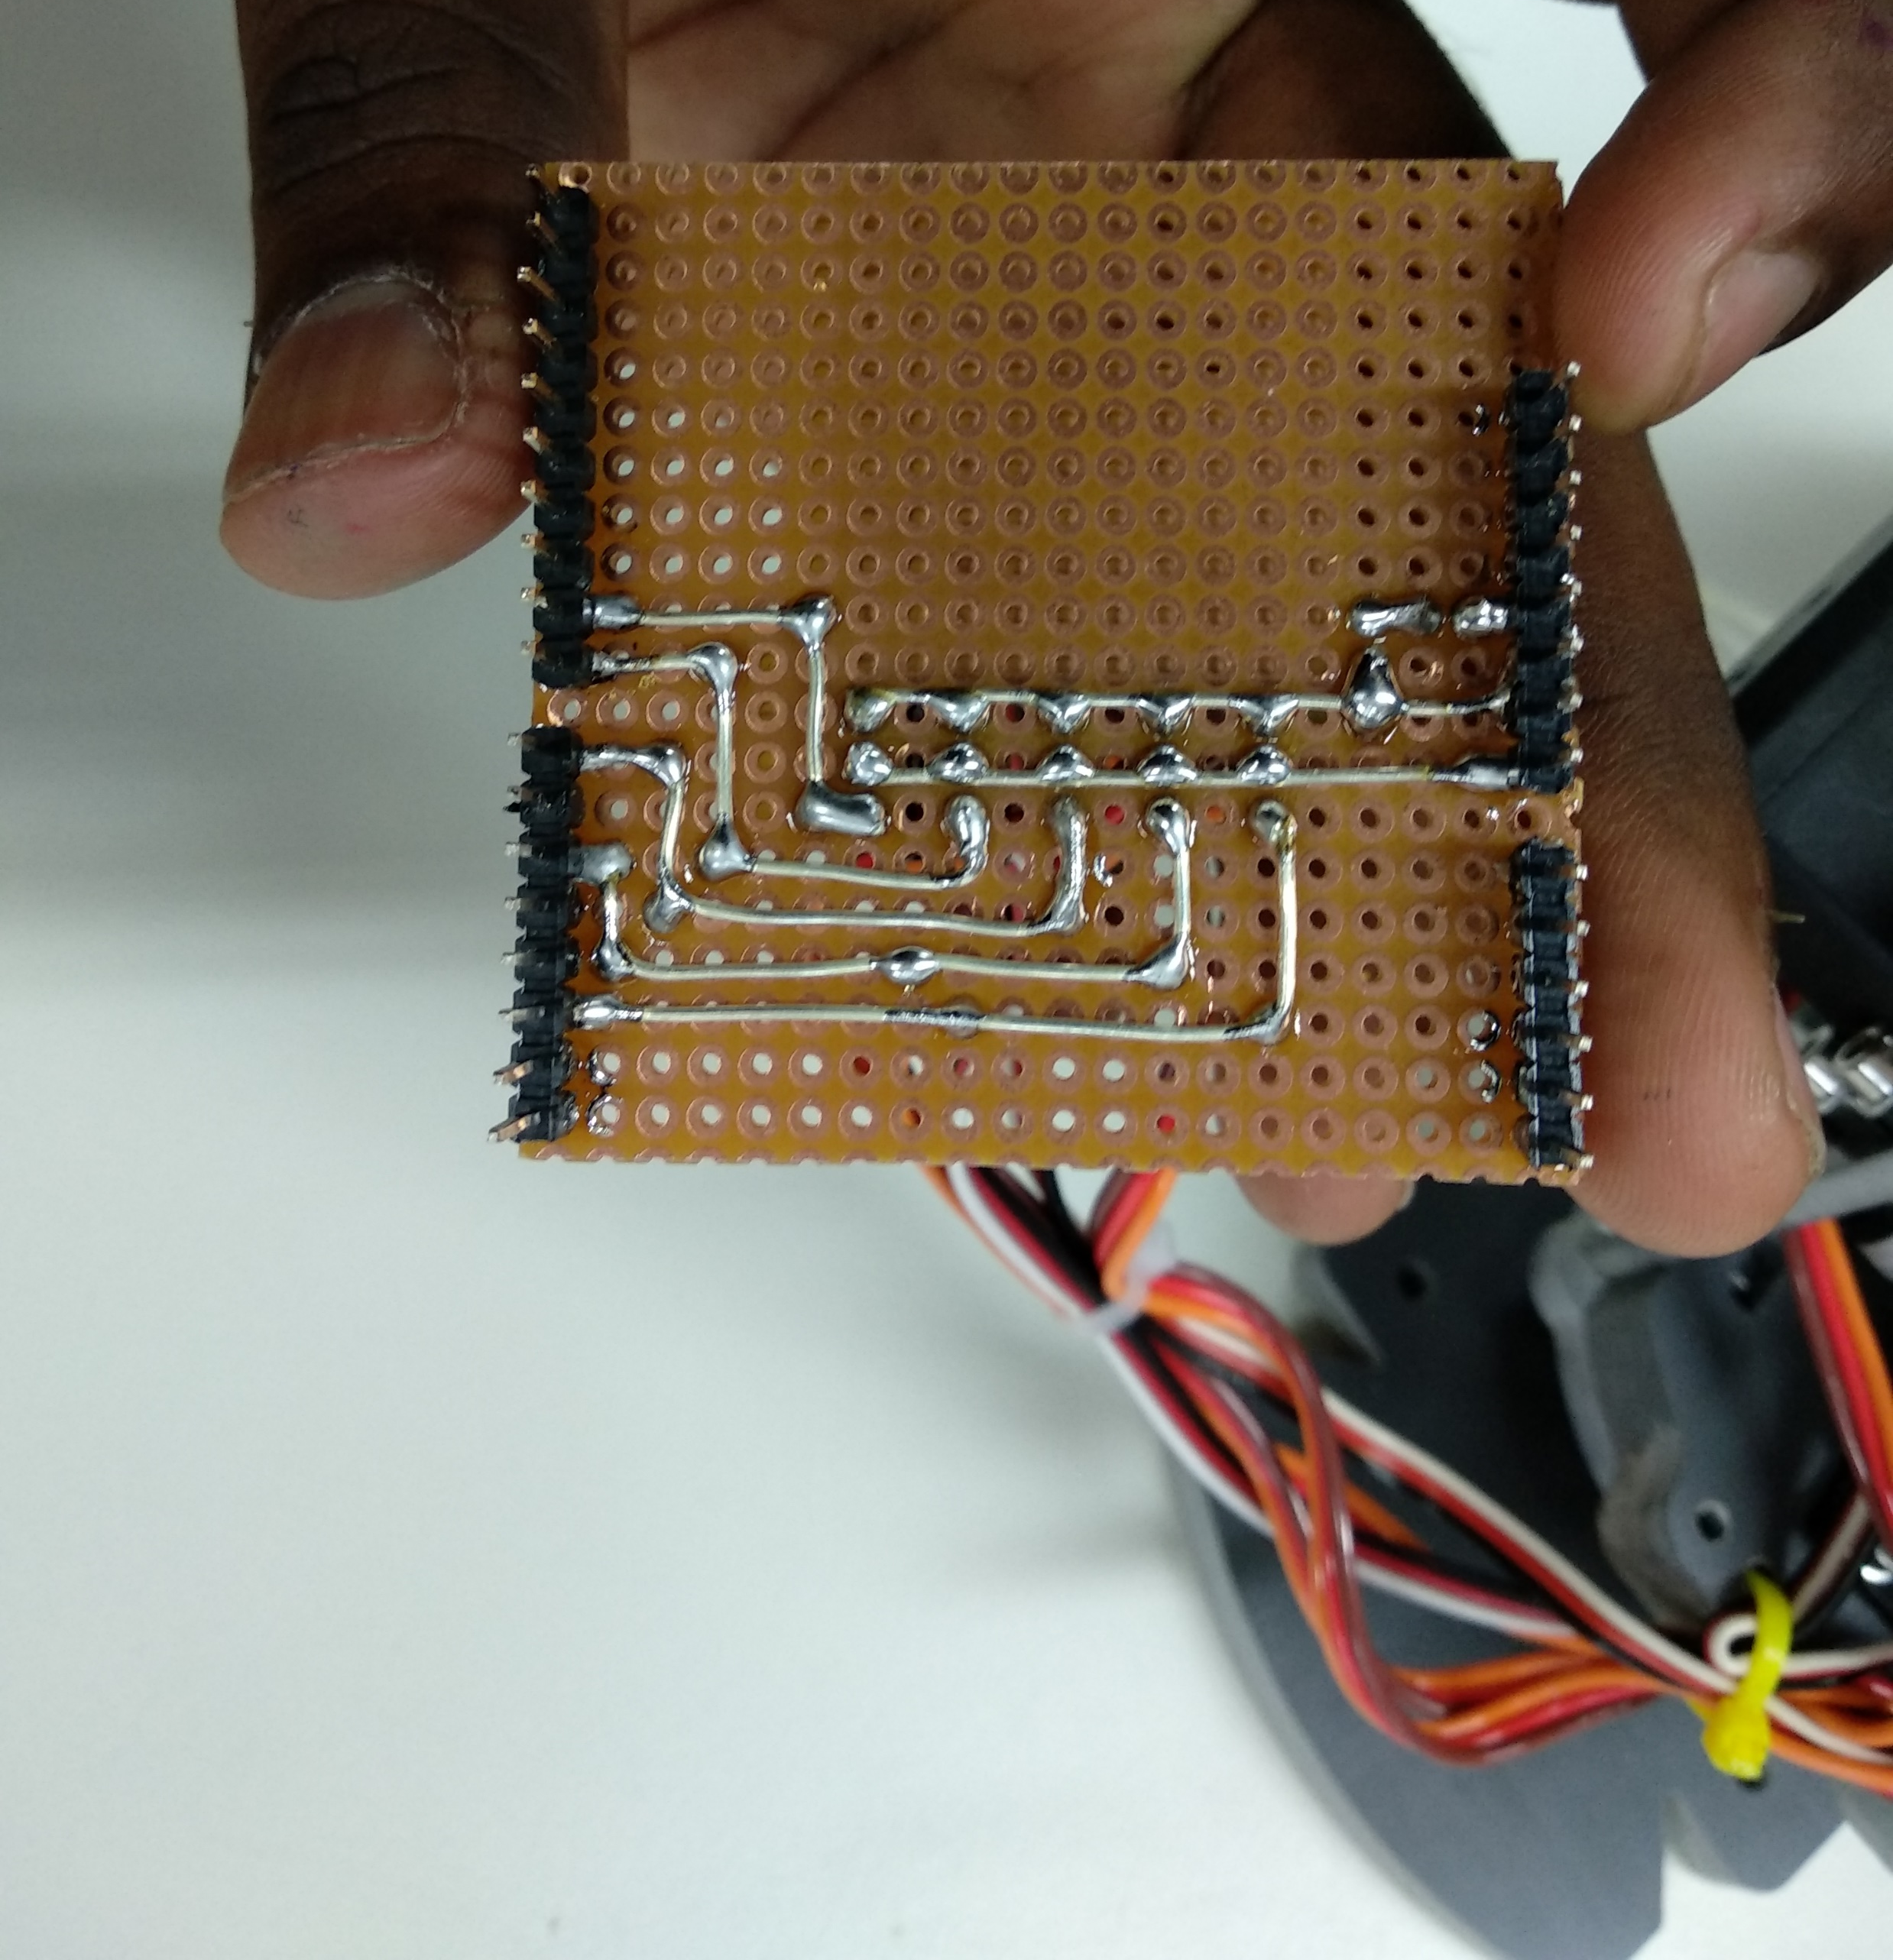
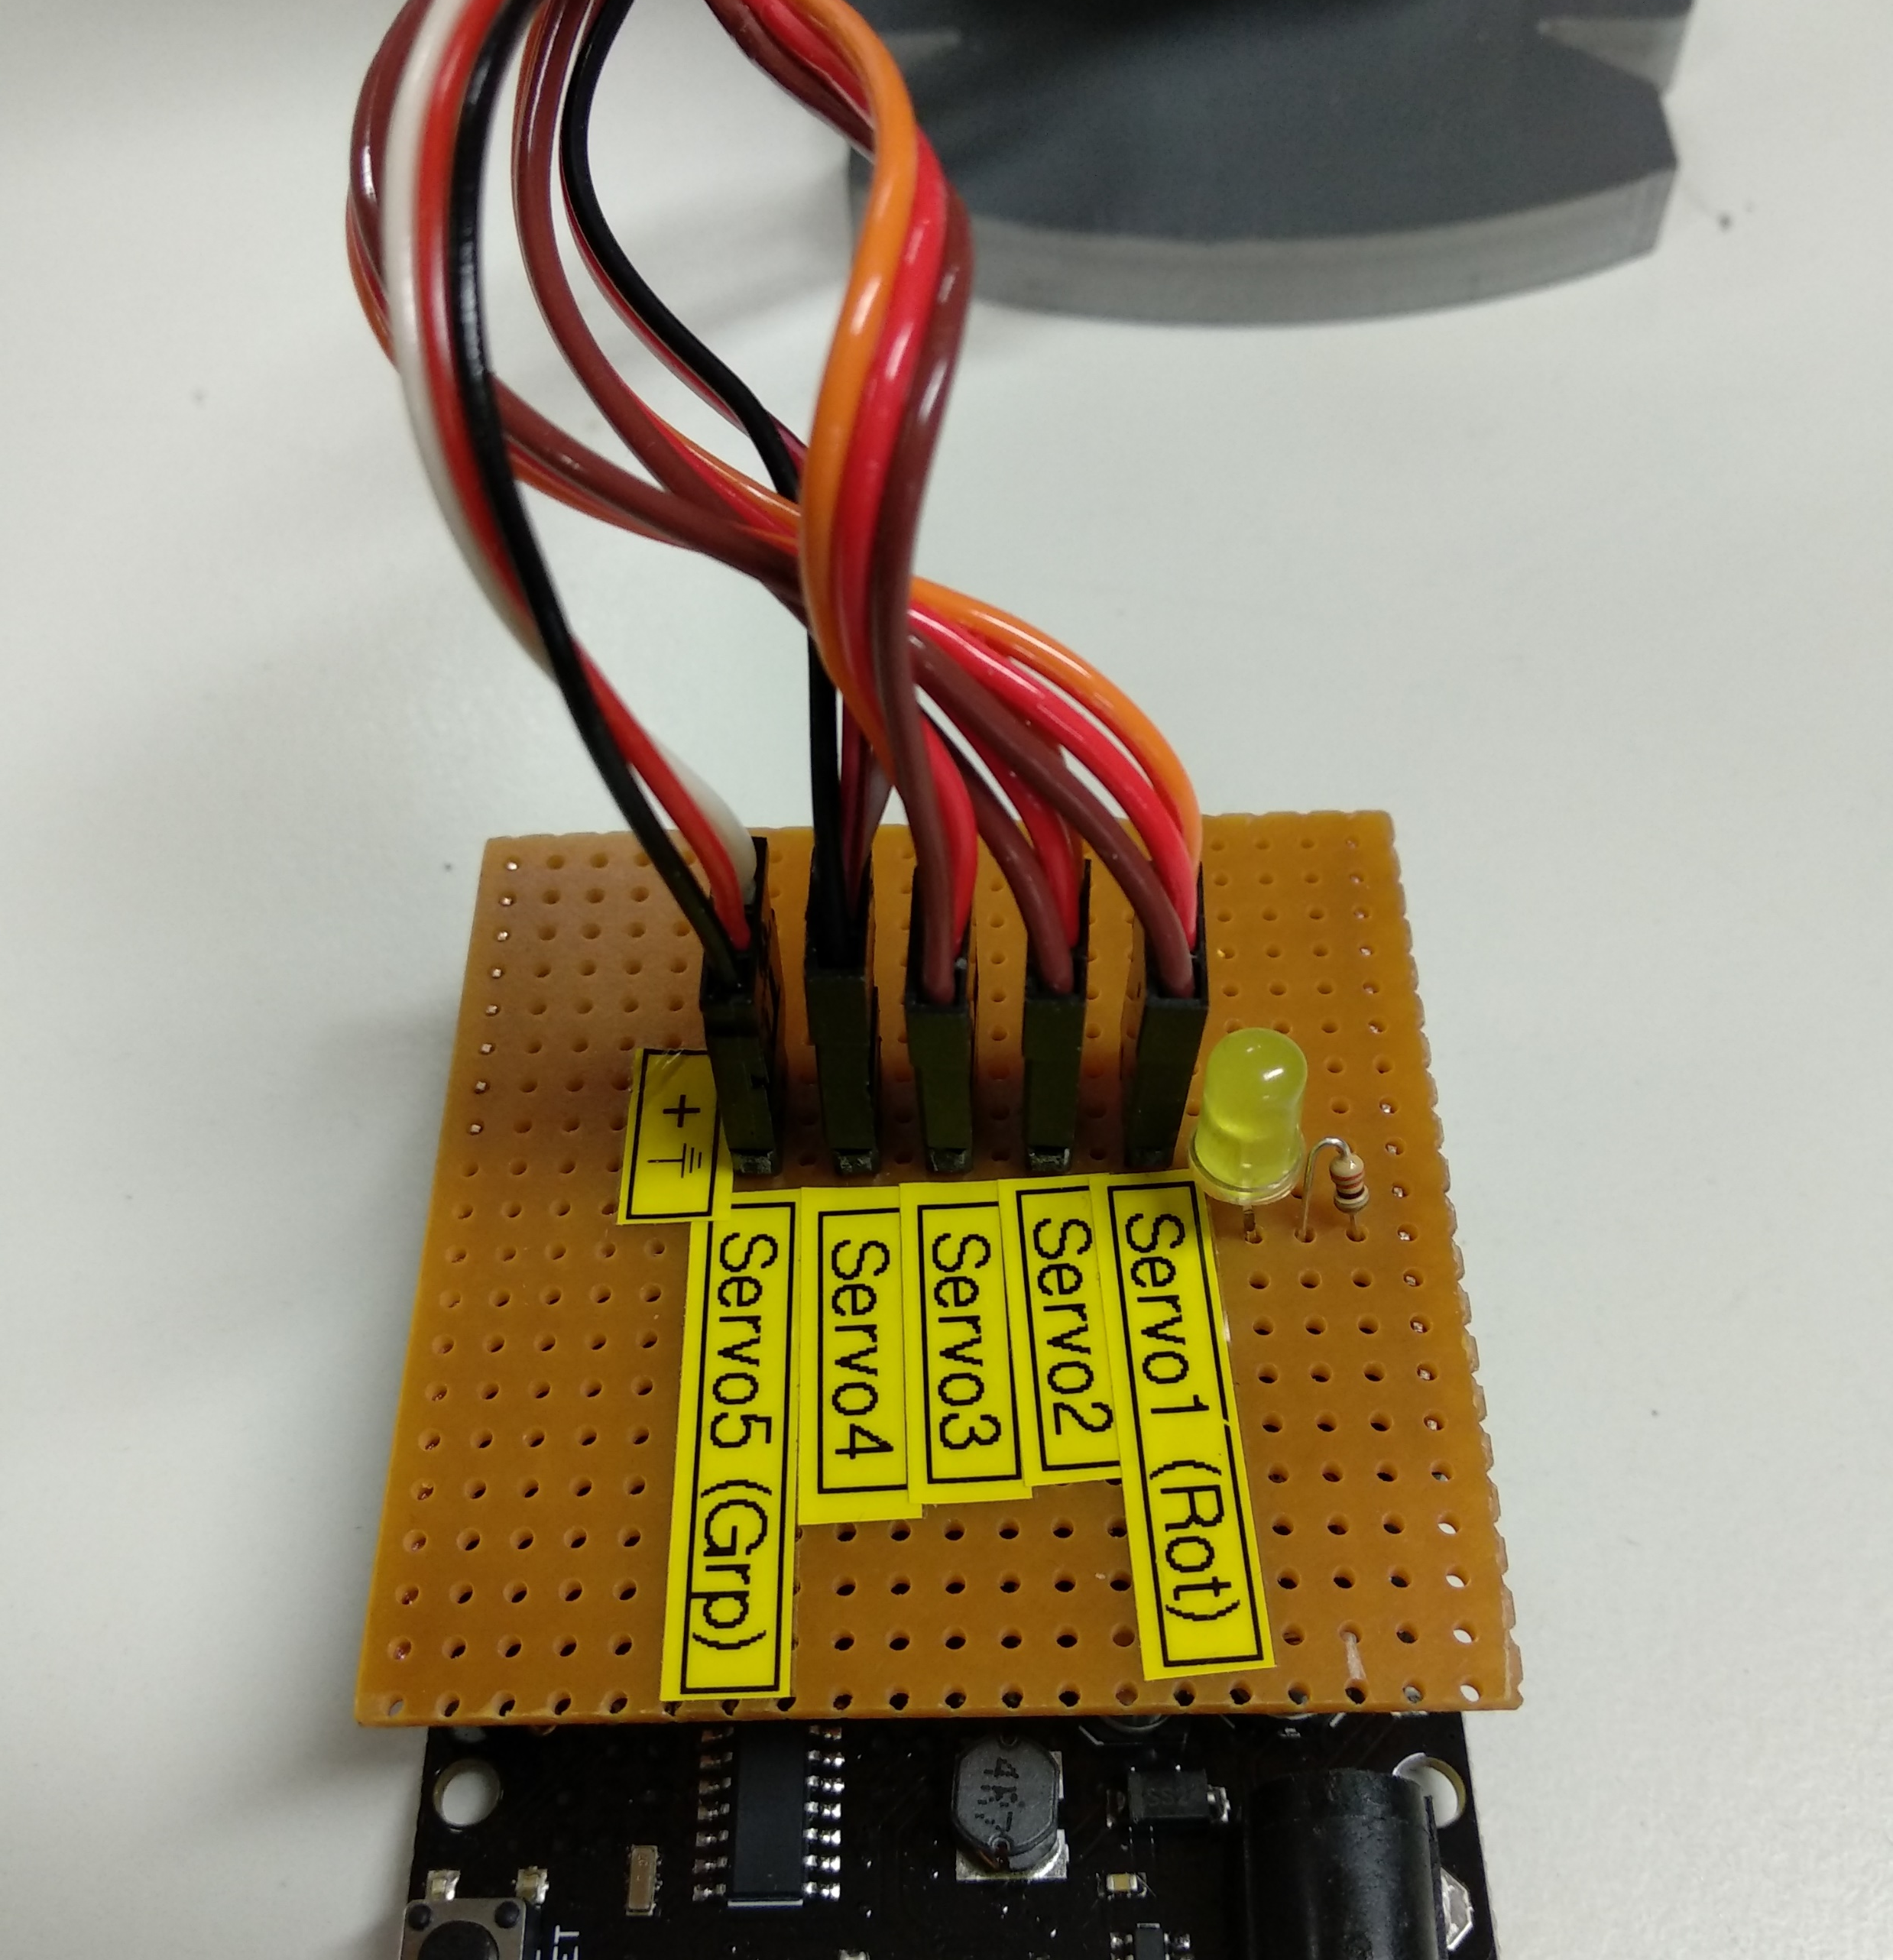
SPRINT 3
Soldering of Robot Shield (By Prof. Stahl)

